Slide 1
Parallel Poisson Disk Sampling
Claudia Noche
Jean Paul Huby

Slide 2
Topics
What is Poisson Sampling?
Previous work
Methodology
Data structure
Algorithms used
Considerations
Implementation
Conclusions

Slide 3
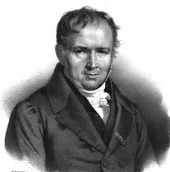
Who/What is Poisson?
The Poisson Distribution
is a discrete probability distribution that expresses the probability of a an event occurring in a fixed interval of time or space.
French mathematician
Siméon Denis Poisson
https://en.wikipedia.org/wiki/Poisson_distribution

Slide 4
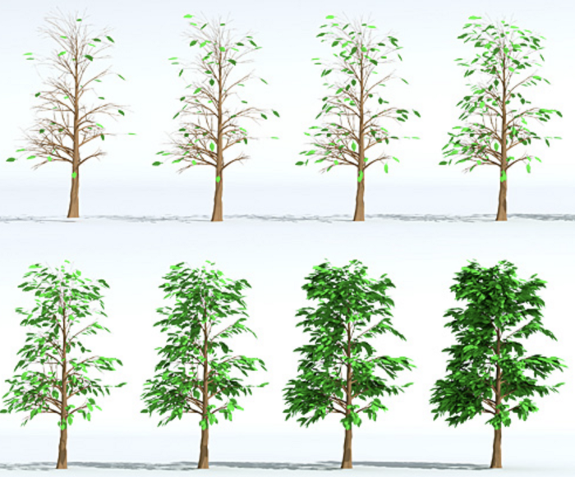
What is Poisson Disk Sampling?
Poisson disk sampling distributes all samples that are uniformly and randomly located.
As opposed to other sampling algorithms, Poisson provides the most uniform results
The closeness is defined by the Poisson disk radius, which is the half distance between the two closest samples
A Sequence of tree leaves placed on the surfaces of the branches using weighted sample elimination by Cem Yuksel.
https://medium.com/@hemalatha.psna/implementation-of-poisson-disc-sampling-in-javascript-17665e406ce1
Notes:
. Last but not the least, the exact geodesic distance should be used to enforce the minimum distance constraint between any pair of samples

Slide 5
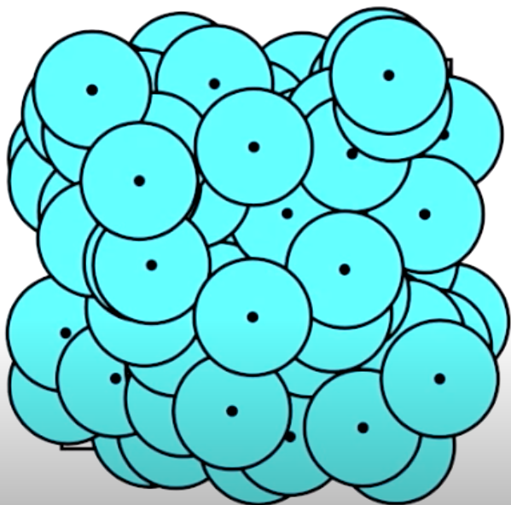
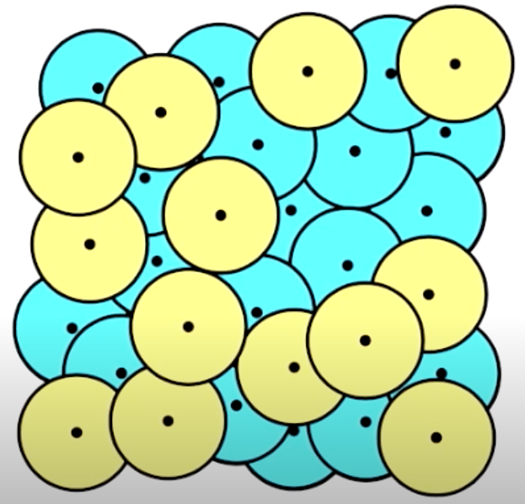
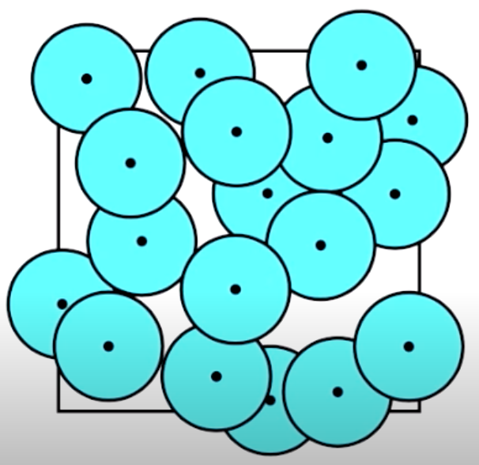
Previous work → Dart Throwing
https://www.youtube.com/watch?time_continue=4&v=G94y3YRqSHk&feature=emb_logo

Slide 6
Poisson Disk Sampling
Poisson Disk Sampling in IR^{n}
Dunbar and Humphreys presented a spatial data structure in 2D.
Cannot expand into another dimension
Gamito and Maddock presented an algorithm for euclidean space of arbitrary dimension
Space and time complexity O(nlogn)
Chen and Gotsman presented a parallel algorithm of the Poisson Disk Sampling.
Poisson Disk Sampling on Surfaces
Most of these algorithms adopt some spatial data structure:
Explicitly partitions the surface
Subdivide the surface
Maintains the region
But they implemented in a way that it can
Work in IR^{n}
The generated samples are distributed uniformly and randomly
The samples doesn’t experienced conflicts
Is parallel

Slide 7
Data Structure
enum SampleStatus{
IDLE,
ACTIVE,
ACCEPTED,
REJECTED,
};
struct Sample{
SampleStatus status;
float priority;
vector3d pos;
int face_id;
};
list<Sample> S
vector<Sample> P
vector<int> PointIndex
list<Sample> A[T]
list<Sample> I[T]

Slide 8
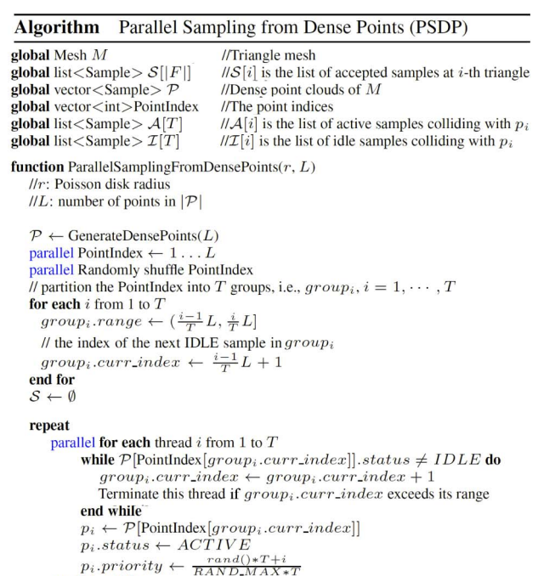
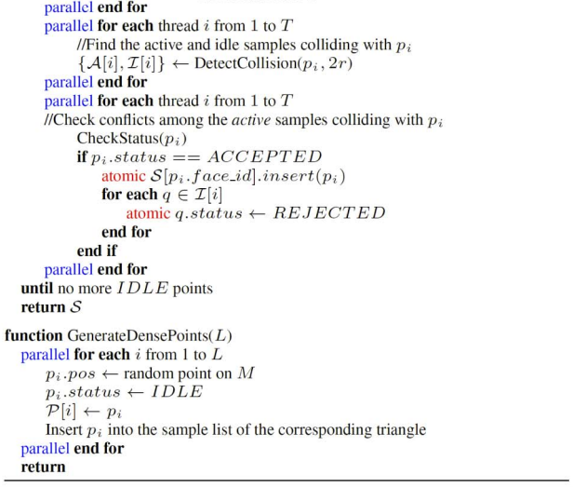
Pseudocode

Slide 9
Parallel Poisson Disk Sampling on Surfaces
Parallel Sampling from Dense Points
Converts the input mesh into a set of dense points P
Randomly selects the samples from P
Processes them as PDTS
Works for arbitrary surfaces

Slide 10
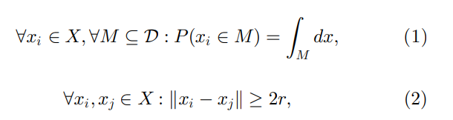
Correctness
Random sample s has a probability of falling inside a subset M of the domain D that is equal to the hypervolume of M.
Any two samples are 2r apart from each other

Slide 11
Results

Slide 12
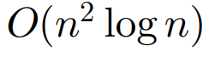
Analysis → Performance
DetectCollision() →
Sampling speed is directly proportional N is increasing
HOWEVER
when N is bigger than the number of mesh vertices, the sampling speed does not depend on N anymore, since the time for computing the geodesic disk is insignificant and remains roughly constant.

Slide 13
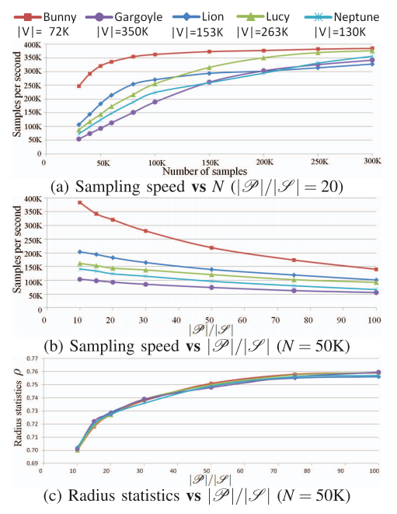
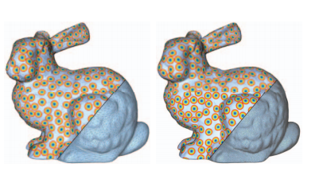
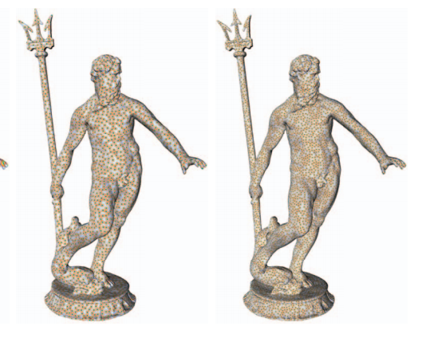
Bunny
Neptune
The spectra of the method is consistent with the blue noise patterns in all the examples.
The more points in |P|, the larger pool of samples there are to choose.
Notes:
P = number of presambled points

Slide 14
Conclusion
With the parallel dart throwing on surfaces (PDTS), we can have a better picture of how does Poisson disk sampling works.
Poisson disk sampling is much more efficient using parallelism.
As a result of manipulating the spatially varying density function, we get adaptive sampling easily.

Slide 15
Thanks!

